Slide 1
Lesson 9: Documentation
This document documents documentation
Ben Schwarz

Slide 2
Introduction
It can be hard to understand what a program is doing sometimes. And not just what it is doing, but why it is doing it. Imagine you're trying to read someone else's code, and you have no idea what it's doing. That doesn't sound very easy.
Now imagine you're trying to read your own code... that was written at 3am 5 months ago. That also doesn't sound very easy.
Alternatively, try to imagine code that was written at 3am last night... and now it's 4am, the day before competition. That sounds like the exact opposite of easy.
Luckily, there is a convenient solution to this. It's called documentation. Remember to always document your code. Pro-tip: always document your code.
Seriously always document code.

Slide 3

Single Line Documentation
Simple, whenever you want to explain something add //and the compiler ignores whatever happens after this point on the line.
You don’t even need a semicolon at the end of the line.
However you do need one at the end of a normal line so you would need one before the code if there was code written on the line.
Example:

Slide 4
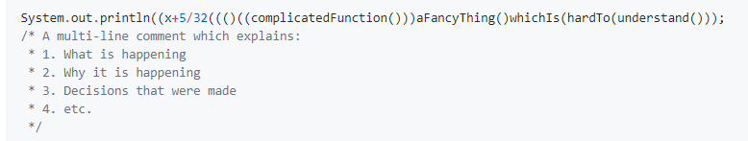
Multi-Line Documentation
You can also write more complicated documentation that goes over multiple lines. Multi-line comments start with /* and end with */. Each line that is documented should start with * (eclipse/your IDE should help with that.) For example:

Slide 5
Javadoc
Java provides some super-helpful extra documentation tools to keep things easy to understand (and use).
Javadoc helps you write useful documentation for functions(or classes), which will show a description, inputs, what it returns, and other tags (like author, errors it may throw) if desired.
The javadoc will show in the "ctrl+space" autocomplete list, and if you hover your cursor over the function name (you may need to press f2 for it to show up.) Javadoc can also be used for classes.
To create some javadoc, on the line before the function decleration, type /** (two asteriks) and hit enter. Eclipse will auto complete some useful stuff (although you can always write it manually.)
You can also use it to generate document sheets for people to read about your code. You may see this when you read documentation on java classes and functions online.
This can be helpful if you have a desire to sell code for people to use and keep the innerworkings secret or stop people from messing with it while allowing people to use it in their code. For more info on this I suggest researching online.

Slide 6
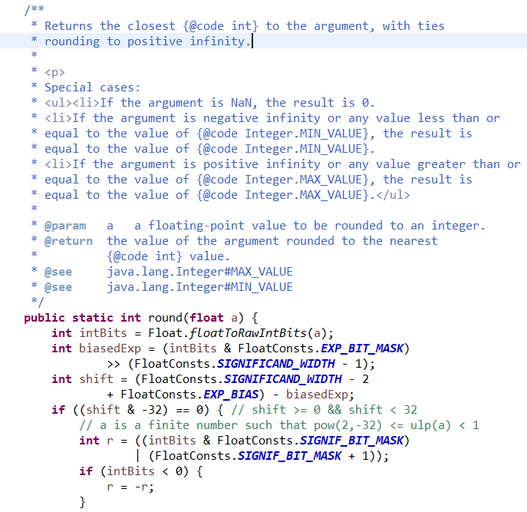
Javadoc Example:
This is documentation from a real function I took from the java API. Would you have had any idea what the code did without the documentation, or the special cases. This is why documentation is important.

Slide 7
Writing Effective Documentation
Documentation should be:
Brief and descriptive.
Explaining 'why' something was done a certain way, not how.
Explain any odd or unusual things about the code (e.g. you tried to do something x way, but it didn't work because y function is doing z odd thing, so you have to use this other odd-looking way to get it to work.)
Formal and polite (No rude words, even if you're frustrated.)
Note that variable names and function names should be descriptive.
Also Note that your code should (generally/nearly always) be simple enough to not need excessive amounts of comments. If you go online, you will find some people who try to write code so neat and simple that it doesn't 'need' comments. Other people claim the same thing, saying that it's self-documenting, even when other people can't understand it. All those people are wrong. Your code should be both simple and well-organized, and documented well. Generally I will split every couple (4-8) lines of code into blocks, which achieve/do something, and then put a short (~6 word) comment at the top saying what that block does.
Let’s look at some bad documentation.

Slide 8
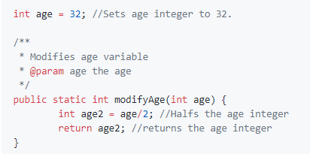
Bad Documentation 1
Not only is the documentation super-obvious and unhelpful, but it clutters the code and makes it hard to read. Function names and variable names need to be more descriptive, and the javadoc for the function is just stupid.
A good documentation would be simply in the Javadoc saying it halves the age (remember people may be selected which function they want to use from a large number and don’t have time to go trawling through all your code as well as unnecessary documentation.

Slide 9
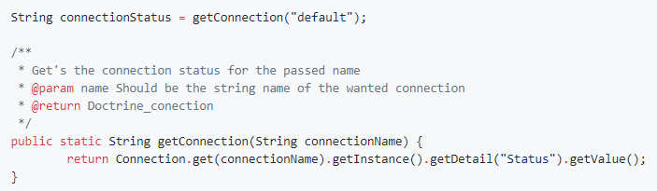
Bad Documentation 2
Here the javadoc doesn't actually tell you anything useful, rather just taking a lot of time to be confusing and over-detailed. Meanwhile the ridiculous return Connection.get(connectionName).getStatus(); line, which needs an explanation as to why it's code (and the code of Connection) is so horrifying.
Don't let those examples of bad documentation deter you though. It is always important to document, even if it's tempting not to.
Pro-tip: document.

Slide 10
Activities
8.
This isn't really something I can give an activity for... so there are none! If you want practice, feel free to go back and try documenting some of the code you wrote for previous activities. If you want some extra reading, here is a good article on documentation: https://medium.freecodecamp.com/code-comments-the-good-the-bad-and-the-ugly-be9cc65fbf83
Hope you enjoyed this module! You now know a lot about the basic of code. In the next module, Algorithims, we'll start looking at how to write cool code to solve big problems.
Suprise! There are some activities, but they're summary activities. Do document what you do though.
Write a function which, when given two numbers, say a and b, returns a to the power of b. (No using Math.pow)
Extension: Write a Java method to compute the future investment value at a given interest rate for a specified number of years. Sample data (Monthly compounded) and Output:
Input the investment amount: 1000 Input the rate of interest: 10 Input number of years: 5
Expected Output:
Years Future Value 1 1104.71, 2 1220.39, 3 1348.18, 4 1489.35, 5 1645.31

